Slide 1

Event Sourcing to the Rescue
Alex Michel
CTO, iFOREX Group

Slide 2
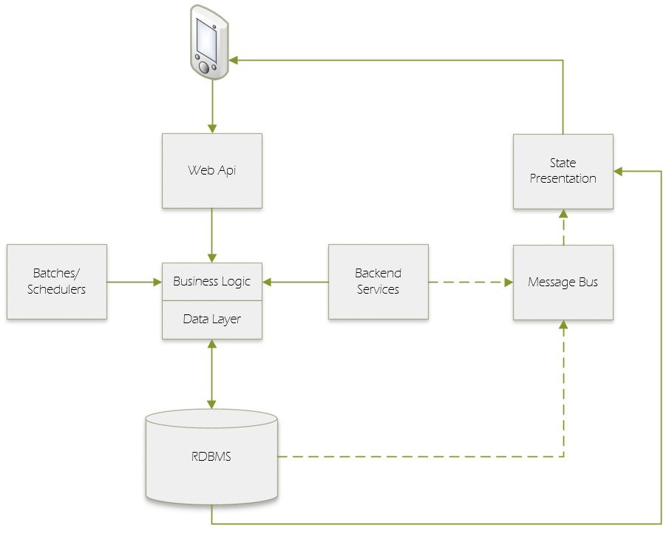
Legacy System Architecture (simplified)

Slide 3
Problems
Latency
Locks, Paging and Context Switches: 100s of processes compete on same DB and same records
Race Conditions
Different flows and pieces of logic running in 100s of processes naturally have race conditions
Operational Costs
Complex schema due to multiple optimizations requires more maintenance
Need for out of process calls for validation and CRUD operations
Race conditions must be handled explicitly by means of optimistic or pessimistic concurrency controls
Random IO
In distributed system, often flows are too complex, causing race conditions which are hard to detect and address, with more risk for concurrency bugs and hard to implement synchronization code
Need for advanced and costly monitoring tools, that add some performance penalty
Downtime during software upgrades, due to incompatible DB schema or long migration scripts
Requires expensive storage optimized for intensive random IO
High-priced VM sizes and storage types when running in cloud environments

Slide 4
Event Sourcing
Capture all changes to an application state as a sequence of events.
i.e. - Don't save the current state of objects - save the events that lead to the current state
Properties
Events are immutable
Features
Recover state
Event store is append only event log
Events are the only source of truth
Projections are views over event store
Time travel (recover to point in time)
Replay events
Replicate state
Built-in audit log
Simulate state
Consume events stream outside of system

Slide 5
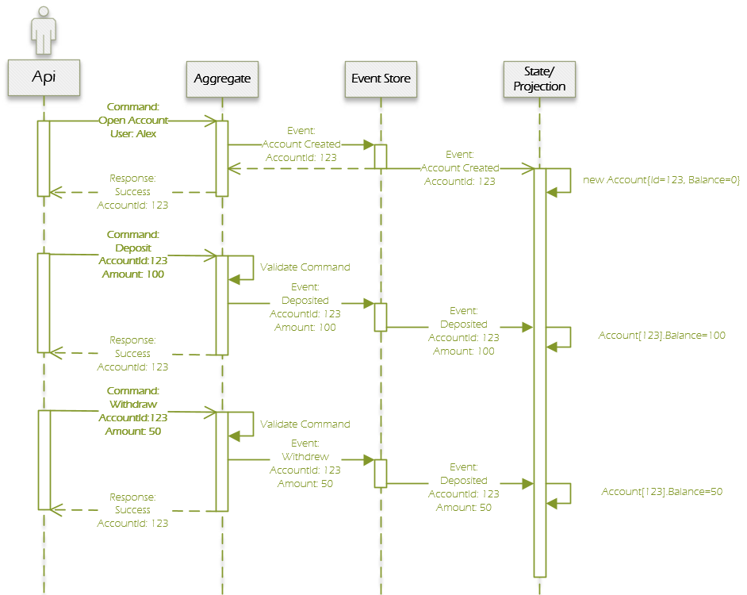
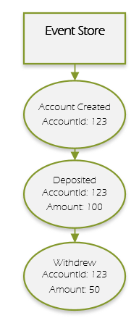
Event Sourcing

Slide 6
Event Sourcing vs CRUD – 1
ES
In-memory state
CRUD
State validated in DB
Random IO
Sequential IO
Built-in audit trail
No race conditions
Requires synchronization
Custom audit trail
Replay events
Hard to implement due to schema changes
Loose coupling on storage/DB
Tightly coupled to DB vendor and implementation

Slide 7
Event Sourcing vs CRUD – 2
ES
Requires deep domain knowledge
CRUD
Understanding of data model
More conventional
Learning Curve
DDD - modelling efforts
Less modeling efforts – easier to start
Suitable for specific domains
Works in many domains
Event log grows – snapshot, retention
Need to implement versioning/migration support

Slide 8
Actor Systems
The actor model in computer science is a mathematical model of concurrent computation that treats "actors" as the universal primitives of concurrent computation.
Why actors?
Actor system is a natural way to implement event sourcing
In response to a message that it receives, an actor can: make local decisions, create more actors, send more messages, and determine how to respond to the next message received.
Actors may modify private state, but can only affect each other through messages (avoiding the need for any locks)
Definition (from Wikipedia)
In my case granularity and scale unit is customer investment portfolio – each customer handled by separate actor instance
State is stored private in-memory. When instance fails, it is recreated by replaying events.
Actor receives commands, validates against local in-memory state
All commands that affect portfolio are routed to relevant instances based on customer account number
Once approved, new events are generated and committed to event store
Events that successfully committed are applied to the state (modify state)
Actor is processing one message at a time – no race conditions for same entity, so no need for OCC, locks or other synchronization code.

Slide 9
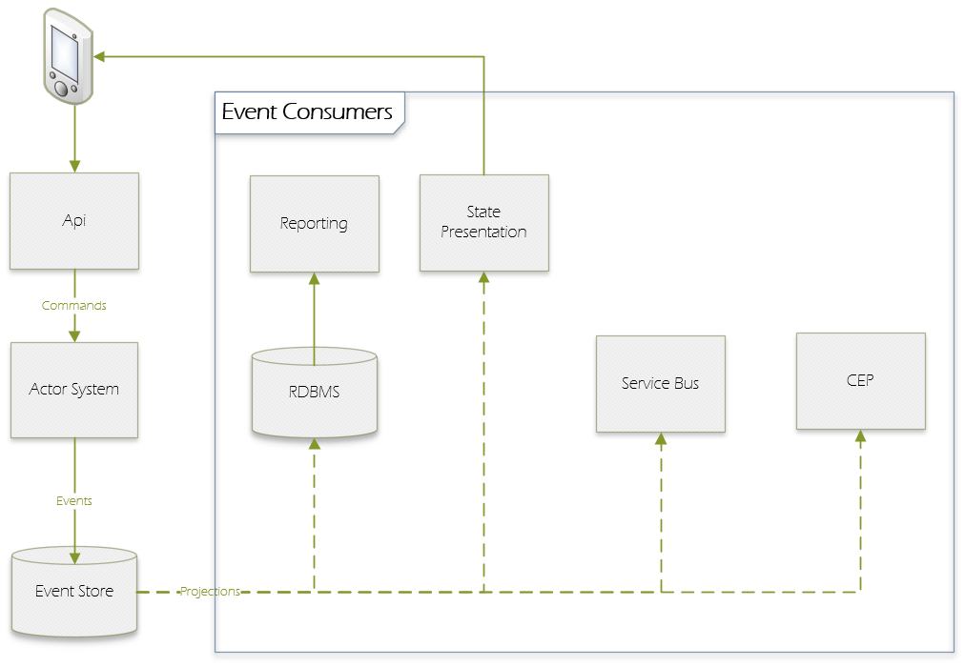
Solution Concept: Event Sourcing + Actor System

Slide 10
Popular Event Sourcing
Version Control
Bookkeeping
Blockchains
RDBMS

Slide 11
Pitfalls, misbeliefs and antipatterns
ES is not a top-level architecture - it is a pattern/practice to apply in specific domains
Do not apply ES to all system
CQRS is not the reason to build ES - but in ES system it comes as natural way to build presentation/read side
Replaying events may cause side effects (e.g. calling 3rd party Api multiple times)
Not suitable for data-centric systems

